Slide 1


Isolating Wide-Area Network Faults with Baywatch
Colin Scott
With Professor Ethan Katz-Bassett, Dave Choffnes, Italo Cunha,
Arvind Krishnamurthy, and Tom Anderson

Slide 2
A Quick Survey
Raise your hand if you used the Internet / email:
…since you got to this room?
…in the last hour?
…today?
Notes:
XXX
At this point, I’m going to assume anyone with hand down is too busy checking email to have heard the question
My point is that we all depend on the Internet

Slide 3
We Need the Internet to Be Reliable
We increasingly depend on the Internet:
Yesterday: Email, web browsing, e-commerce
Today: Skype, Google Docs, NetFlix
Tomorrow: Thin clients + cloud, traffic control, outpatient medical monitoring,…
So, we expect it to operate reliably:
High availability
Good performance
Does it achieve these goals?
Notes:
XXX?
Traditional apps like email and web browsing. E-commerce sites rely on the Internet’s reliable operation for their business
Now, we use to access data and apps in the cloud, to watch movies, and to talk on the phone. We want our cloud data to be reliably available, and we want our movies and phone calls to be smooth
Have to hang up multiple times and retry call
We’re moving towards a world where we’re much more dependent on the Internet
Future: most apps are in the cloud, most communication is over the Internet, want to run critical services
For these apps, we have to be able to rely on the Internet
Are we ready for that?
I’m going to show you that the current answer is no, but that we can take concrete steps towards improving it
What’s the current situation?

Slide 4
Outages happen.
They’re expensive, embarrassing and annoying
They take a long time to fix
Alert
Troubleshoot
Repair
Lack of good tools for wide-area isolation
Notes:
the thing that always strikes me (say, in talking to people at google / amazon / ms, or in reading outages, or talking to colin about his internship) is how much time they spend troubleshooting problems, bc they lack good tools.

Slide 5
Many outages and most are partial
Approx 90% are partial
Number of VPs
Notes:
"holy shit, EC2, a central piece of infrastructure as everything moves into the cloud, has a lot of outages"

Slide 6
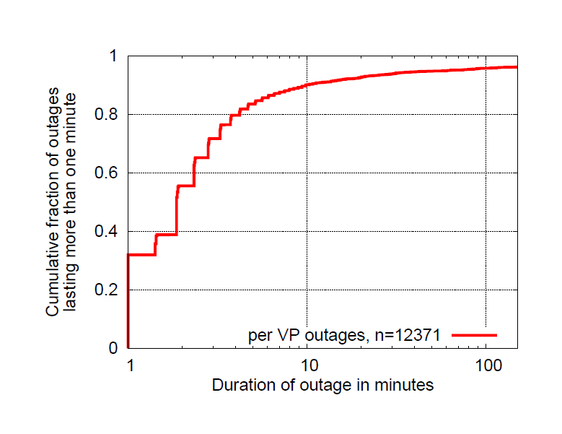
And can be surprisingly long-lasting
Approx 10% last 10 minutes or longer
Notes:
US-WEST, US-EAST, EU-WEST, Singapore
sending pings to 250 targets from the top 50 ISPs
ranked according to UCLA's topology data
one measurement round every 60 seconds

Slide 7
What we know about outages
Hubble also told us they can be …
Frequent and long-lasting
confirmed with EC2 study
Invisible to BGP feeds
Partial
Unidirectional
In ASes outside of source and destination
Notes:
– Frequent and long-lasting
so not fixing automatically, need something
– Invisible to BGP feeds
need active monitoring
– Partial
so suggests working paths exist
also we can leverage the VPs that can reach to reason about those that cant
– Unidirectional
so need revtr
also why doesn't the path work the other way? motivates need for isolation
– In Ases outside of source and destination
avoidance

Slide 8
But where are the outages?
Can’t fix a problem if you don’t know where
State of the art: traceroute
Only tells part of the story
Even with control of source and destination
Especially without control of destination
Notes:
i would give an example here of why traceroute is not enough, that it shows the same thing for forward vs reverse, that it can point out the wrong place. if you wanted, you could also quote an outages "help! what's going on?" type post.

Slide 9
Example confusion (12/16/10)
“It seems traffic attempting to pass through Level3's network in the Washington, DC area is getting lost in the abyss. Here's a trace from VZ residential FIOS to www.level3.com:” – Outages.org list
User 1 1 Wireless_Broadband_Router.home [192.168.3.254] 2 L100.BLTMMD-VFTTP-40.verizon-gni.net [96.244.79.1] 3 G10-0-1-440.BLTMMD-LCR-04.verizon-gni.net [130.81.110.158] 4 so-2-0-0-0.PHIL-BB-RTR2.verizon-gni.net [130.81.28.82] 5 so-7-1-0-0.RES-BB-RTR2.verizon-gni.net [130.81.19.106] 6 0.ae2.BR2.IAD8.ALTER.NET [152.63.34.73] 7 ae7.edge1.washingtondc4.level3.net [4.68.62.137] 8 vlan80.csw3.Washington1.Level3.net [4.69.149.190] 9 ae-92-92.ebr2.Washington1.Level3.net [4.69.134.157] 10 * * * Request timed out.
User 1: Broken link is in DC

Slide 10
Example confusion (12/16/10)
“It seems traffic attempting to pass through Level3's network in the Washington, DC area is getting lost in the abyss. Here's a trace from VZ residential FIOS to www.level3.com:” – Outages.org list
User 2
1 192.168.1.1 (192.168.1.1)
2 l100.washdc-vfttp-47.verizon-gni.net (96.255.98.1)
3 g4-0-1-747.washdc-lcr-07.verizon-gni.net (130.81.59.152)
4 so-3-0-0-0.lcc1-res-bb-rtr1-re1.verizon-gni.net (130.81.29.0)
5 0.ae1.br1.iad8.alter.net (152.63.32.141)
6 ae6.edge1.washingtondc4.level3.net (4.68.62.133)
7 vlan90.csw4.washington1.level3.net (4.69.149.254)
8 ae-71-71.ebr1.washington1.level3.net (4.69.134.133)
9 ae-8-8.ebr1.washington12.level3.net (4.69.143.218)
10 ae-1-100.ebr2.washington12.level3.net (4.69.143.214)
11 ae-6-6.ebr2.chicago2.level3.net (4.69.148.146)
12 ae-1-100.ebr1.chicago2.level3.net (4.69.132.113)
13 ae-3-3.ebr2.denver1.level3.net (4.69.132.61)
14 ge-9-1.hsa1.denver1.level3.net (4.68.107.99)
15 4.68.94.27 (4.68.94.27)
16 4.68.94.33 (4.68.94.33)
17 * * *
User 1: Broken link is in DC
User 2: It’s in Denver?
Is this even the same problem?
What if it’s on the reverse path? (and paths aren’t symmetric)

Slide 11
System for wide-area failure isolation
Goal: Detect and isolate outages online
What kind of outages?
Long-lasting: not fixing itself (needs some help)
Avoidable: requires path diversity, no stub ASes
High impact: outages in PoPs affecting many paths
What kind of isolation?
IP link
How quickly?
Within seconds or small numbers of minutes

Slide 12
What we want out of isolation
Direction (forward or reverse)
Narrowly determine location (link or ASN)
Alternate working paths (facilitates remediation)
Online (allow for immediate action)
So, how do accomplish this?

Slide 13
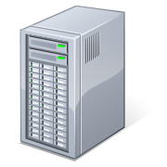

Detecting Outages with Pings
Detecting Outages with Pings
Ping?
Source
Source
Target
Target

Slide 14

Detecting Outages with Pings
Source
Target

Slide 15
Normal traceroute doesn’t work
S’
R2
R3
R1
X
R4
S
Target
Ping T from S, spoofing as S’ and using TTL=1

Slide 17
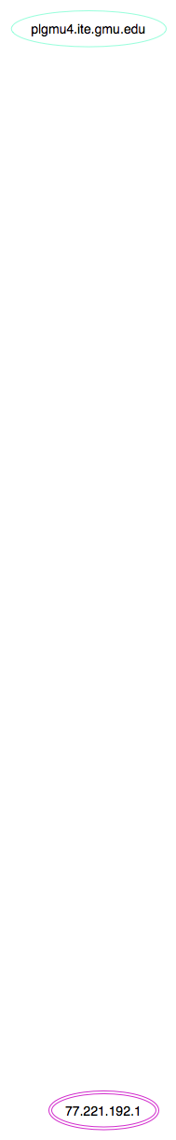

Slide 18
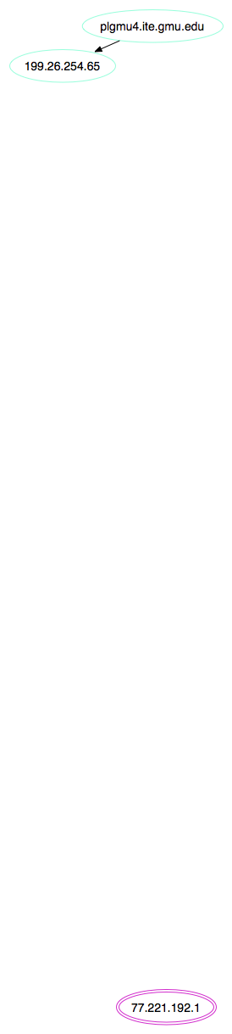

Slide 19
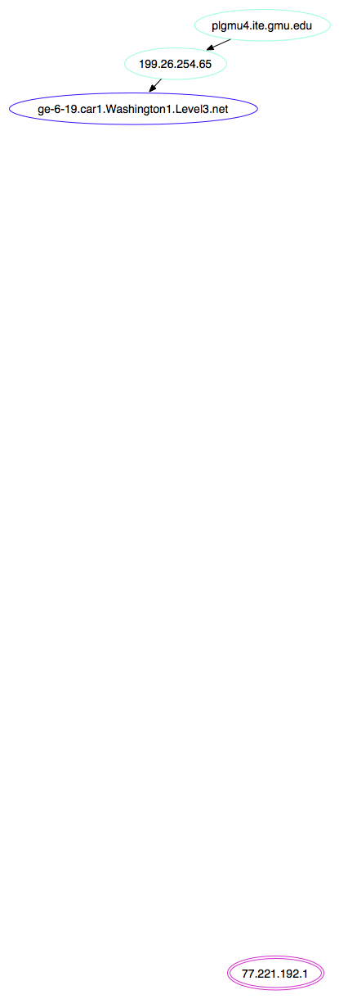

Slide 20
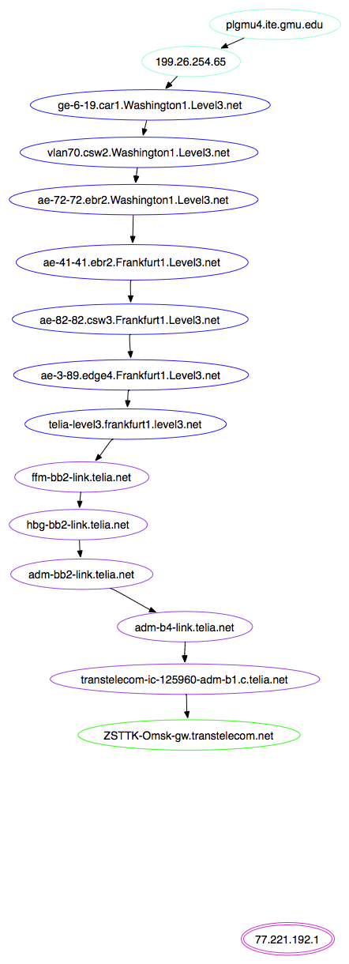

Slide 21
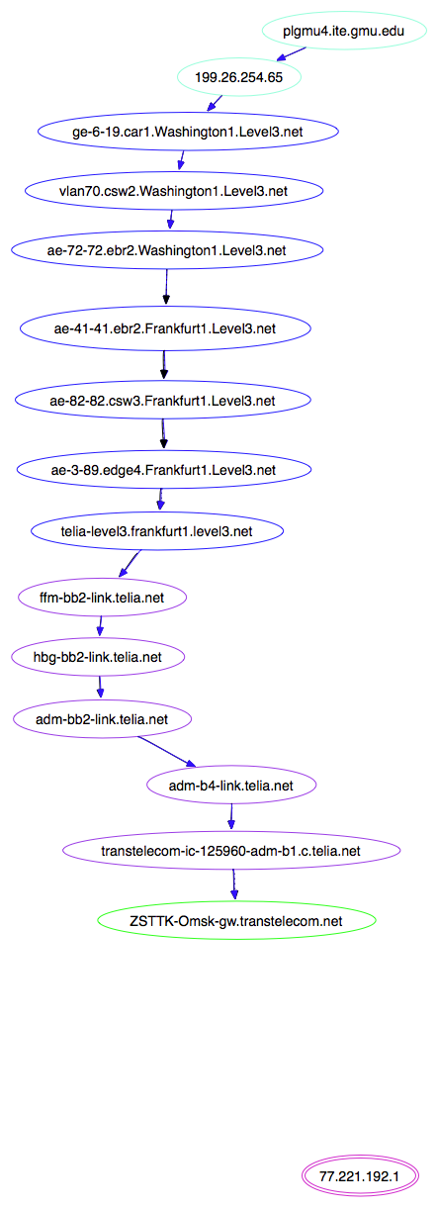

Slide 22
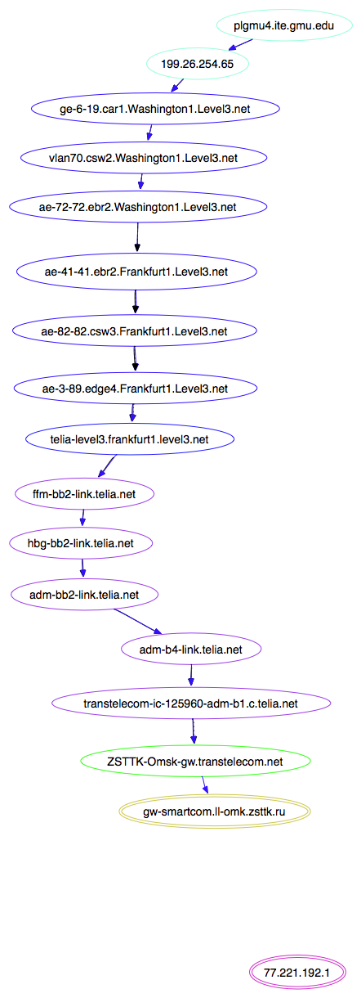

Slide 24
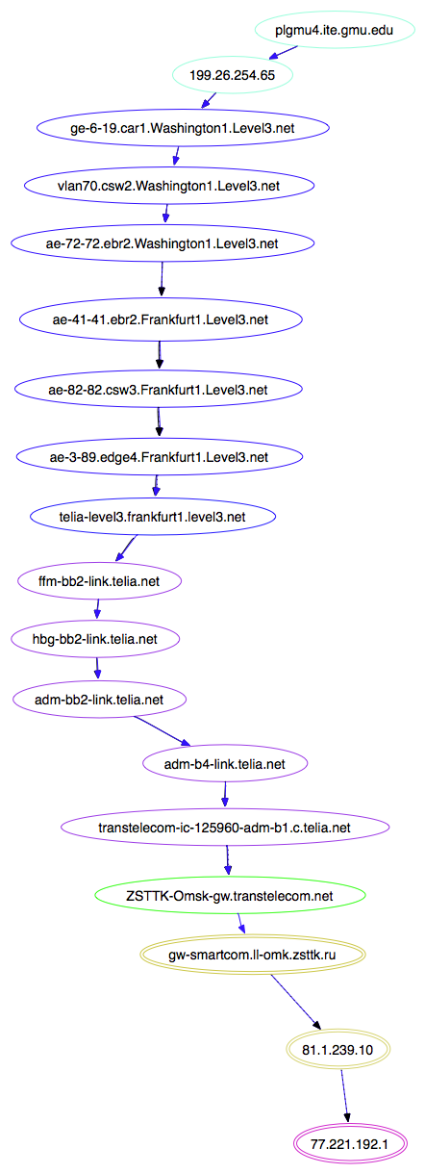

Slide 25
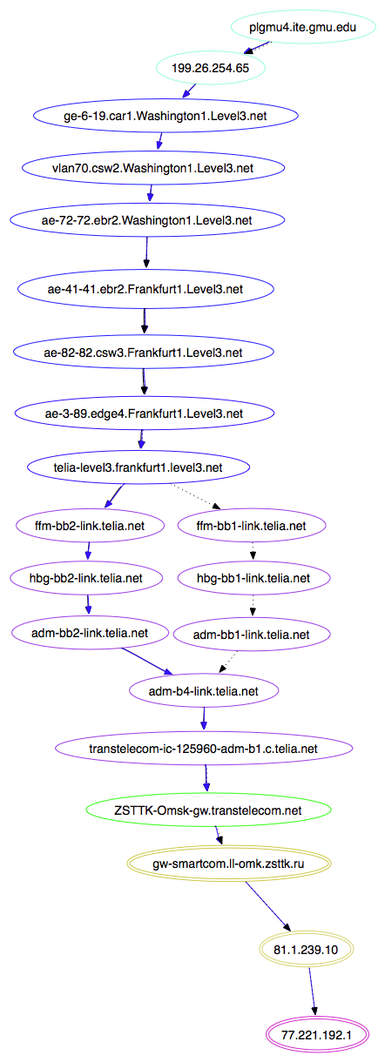

Slide 26
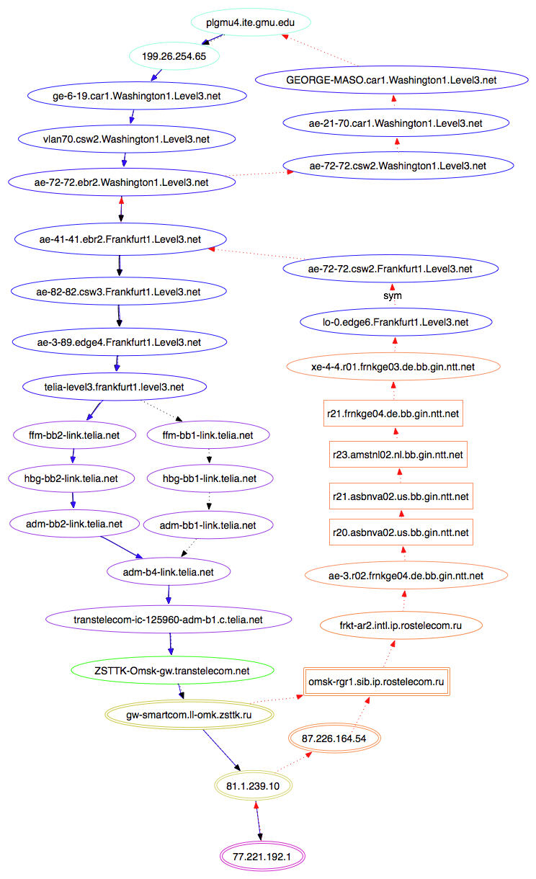

Slide 27
Isolation approach
When outage between two endpoints occurs:
What were the previously working paths?
What are the current working hops?
Combine to infer likely problem links/networks

Slide 28
Enabling isolation during outages
Atlas of path information to “seed” isolation
Rapidly refreshed, historical path information
Forward & reverse traceroute (intermediate hops)
Historical alternative paths
Measurements during outages
Forward hops: spoofed forward traceroute
Pings to historical hops (fwd and rev)
Reverse hops: reverse traceroute
Notes:
Emphasize tools
some other types of measurements we make - pings to historical measurements, forward / rev to intermediate hop

Slide 29
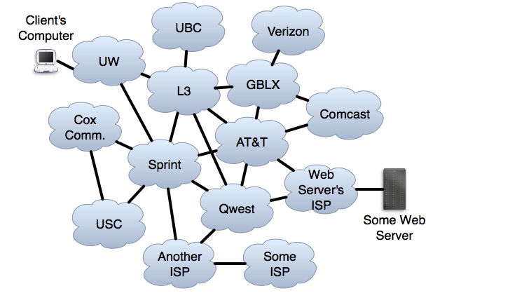
Federation of Autonomous Networks
Notes:
XXX?
Make sure we all have the same basic model of the Internet
Federation of autonomous networks
for a client at UW to talk to some webserver, traffic will take some path from client computer across the Internet, traversing some set of ISPs/ASes, and within each one traversing some routers.
Many routes tend to be pretty stable for long periods - days and days would be common
I’m going to give a overview of how routes are established

Slide 30
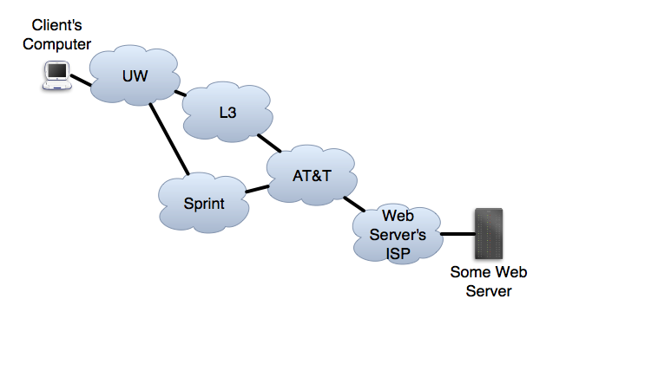
BGP Paths Can Be Asymmetric
UW
L3UW
SprintUW
WSATTSprintUW
ATTSprint  UW
Asymmetric paths are a consequence of policy
Available paths depend on policy at other networks
Network chooses path based on its own opaque policy ($$)
Allowing policy-based decisions leads to asymmetry
Notes:
One of the consequences of policy-based routing is that paths are often asymmetric
Portions may overlap

Slide 31
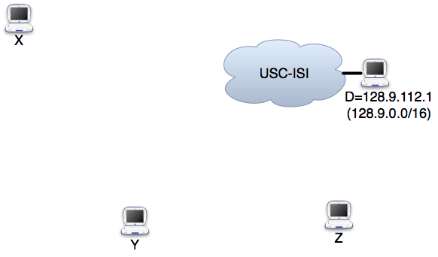
How Can We Locate a Problem?
We have:
Fwd/rev traceroute
Current paths
Historic atlas
Group paths
Notes:
XXX?
As we saw in the Level3 example from the Outages mailing list, can be hard to understand failures bc it can be harder to understand the output of tools
To understand a failure, we need to know what routes look like during the failure
We also need to know what looked like before so we can see what changed
walk through a sample problem to:
Give the flavor of the types of problems we look for
Illustrate how we can start to locate problems
USC Information Sciences Institute
All had been able reach
Suddenly, after having been able to, can’t reach anymore

Slide 32
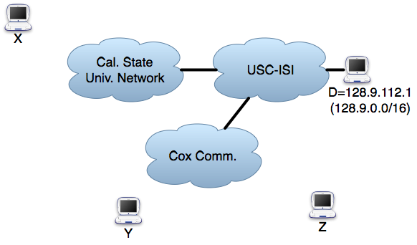
How Can We Locate a Problem?
We have:
Fwd/rev traceroute
Current paths
Historic atlas
Group paths – Looks like Cox failure, but:
Failure could be on reverse path
Cannot tell which ISP is responsible, as paths may be asymmetric
Notes:
CLICK for rev path
Traceroutes alone don’t tell you which direction failure is on EVEN WITH SYMMETRIC PATHS
PLUS paths may be ASSYMMETRIC, so does not even have to traverse Cox on return path
With traditional tools, we’d be stuck, unable to differentiate.

Slide 33
Isolation system
VPs
Targets

Slide 34
Traceroute atlas
Forward traceroutes to all targets
Updated every 5 minutes

Slide 35
Each host traceroutes each target
VPs
Targets

Slide 36
Traceroute atlas
Forward traceroutes to all targets
Updated every 5 minutes
Traceroutes toward measurement sources
Rounds start every 5 minutes
Maximum staleness: 15 minutes
Opportunities for optimization
Great motivation for work on path-measurement efficiency

Slide 37
All VPs traceroute each other
VPs
Targets

Slide 38
Traceroute atlas
Forward traceroutes to all targets
Updated every 5 minutes
Traceroutes toward measurement sources
Rounds start every 5 minutes
Maximum staleness: 15 minutes
Reverse path measurements
Use reverse traceroute technique…

Slide 39
Each VP measures reverse paths
VPs
Targets

Slide 40
Reverse traceroutes
Reverse path info generally requires
IP options support along the path
Limited spoofing
A lot of trial and error

Slide 41
Atlas
VPs
Destinations
Notes:
Don’t worry, this will flash only for second or two ☺

Slide 42
Measurements during outages
VPs
X
Target

Slide 43
Spoofed forward traceroutes
Problem: traceroute can’t measure working forward path during reverse path outage
Need tool that avoids reverse path
SFT: TTL-limited probes spoofed as another VP
Select VPs that are likely to be reachable
Yields forward hops during reverse-path outage
Can provide more information than traceroute, even during forward/bidirectional failures

Slide 44
Simple (real) example
plgmu4.ite.gmu.edu to pl2.bit.uoit.ca
Normal traceroute
1. 199.26.254.65
2. 10.255.255.250
3. 192.70.138.121
4. 192.70.138.110
5. 216.24.186.86
6. 216.24.186.84
7. 216.24.184.46
8. * * *
9. * * *
10. * * *
11. * * *
12. * * *
Spoofed traceroute
1. 199.26.254.65
2. 10.255.255.250
3. 192.70.138.121
4. 192.70.138.110
5. 216.24.186.86
6. 216.24.186.84
7. 216.24.184.46
8. 205.189.32.229
9. 66.97.16.57
10. 66.97.23.238
11. pl2.bit.uoit.ca (205.211.183.4)

Slide 45
SFT during a failure
VP
VP
Ping Target from S, spoofing as each VP
X
Target
Source
VP
VP

Slide 46
SFT during a failure
VP
If they reach spoofers, failure must be on reverse path
Spoof receiver
X
Target
Source
VP
VP

Slide 47
SFT during a failure
S’
R2
R3
R1
X
R4
S
Target
Ping T from S, spoofing as S’ and using TTL=1
Notes:
How do we know which routers to spoof? Historical path information.

Slide 48

SFT during a failure
R1:
S’
R2
R3
R1
X
R4
S
Target
Ping T from S, spoofing as S’ and using TTL=2

Slide 49
Test each reverse subpath
R1:
R2:
S’
R2
R3
R1
X
R4
S
Target
Now we know the current forward path

Slide 50
Test each reverse subpath
R1:
R2:
R3:
R4:
S’
R2
R3
R1
X
R4
S
Target
Now we know the current forward path

Slide 51
Isolating on reverse path
R2
R3
R1
R4
S
Target
X
Aha! It’s the reverse path from R3
Notes:
…and this is why historical info is important

Slide 52
Putting it all together
Find spoofing VPs that reach T
Determine working direction (if any)
Forward: have S spoof toward T as VP
Reverse: VP spoof toward T as S
Failure cases
Forward-only : spoof traceroute
Reverse-only: reverse traceroute to each fwd hop
Bi-directional: spoof traceroute

Slide 53
Early results
Location (~2500 total)
PL/Mlab: 1241
Top 100: 1220
CloudFront: 38
Duration: Average is 453 seconds
Directionality
Forward: 860
Reverse: 130
Bi-directional: 439
The rest were indeterminate (different path, fixed by time of isolation, …)

Slide 54
Evaluation plan
Coverage
How much of the network can we monitor?
How precise is isolation?
Effectiveness
When affecting CDN, try application layer
Corroborate with NANOG
Post to outages.org

Slide 55
Summary
System for wide-are failure isolation
Detection at fine granularity
Algorithm for isolation
Historical, rapidly refreshed path atlas
Spoofed probing to measure during outage
Ongoing work
Refining isolation
Identifying opportunities for automatic remediation

Slide 56
Questions

Slide 57
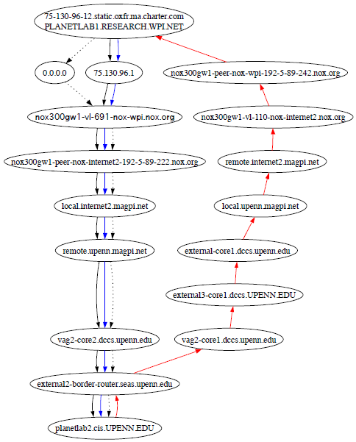
Ongoing visualization work

Slide 58
Goals of outage remediation
Identify paths that
Avoid isolated outage
Offer decent performance
Can be used in real time

Slide 59
Potential Approaches
Change which route you use
Fixes only reverse path problems
Detouring
Requires hosts along alternative working paths
Make an angry phone call
Does this ever work?
Craft BGP announcements to control how others route toward you
Notes:
it doesn't currently touch on the idea of using iplane to build a set of paths, in general doesn't talk that much about how we are also trying to find alternate paths that seem to work
it doesn't address how we plan to evaluate

Slide 60
SFT for forward failure
R1:
R2:
R3:
X
S’
X
R2
R3
R1
R4
S
Target
S’ pings T spoofing as S
Try forward path using SFT

Slide 61
Improving outage response time
Move from human to computer timescale
Detection
Hubble, NEWS
Isolation
Remediation

